Slide 1


Weather Influences on the Flu
Beth Emborsky
Brodie Armstrong
Mark Alcocer

Slide 2
“Climate is what we expect, weather is what we get.”
- Mark Twain
Notes:
With the global pandemic of Covid-19, we wanted to look and see how weather in the past has influenced cases of the flu

Slide 3
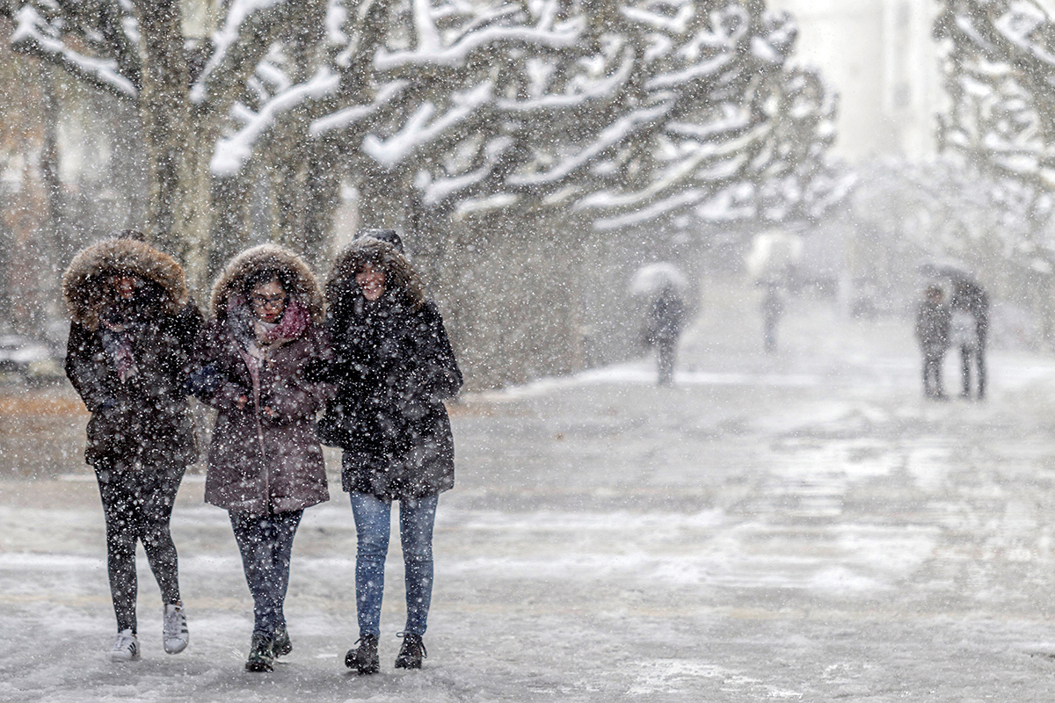

Weather Impact on Influenza Outbreaks
Our project is to uncover patterns in influenza case breakouts based on weather patterns. We’ll examine relationships between types of influenza and location; trends in influenza over the course of the year; and related questions, as the data admits.

Slide 4
Questions & Data
What is the relationship between flu and temperature?
What is the relationship between flu and other weather parameters (e.g. humidity, precipitation totals)?
Is there a common relationship amongst different types of flu?

Slide 5


Data Sources
Weekly flu data from the CDC & WHO at the state level in csv format
Daily observed average temperature and precipitation from The Weather Company in csv format
We focused on 11 large US cities that were scattered across the country
Atlanta, Chicago, Dallas, Denver, Houston, Los Angeles, New York, Philadelphia, Phoenix, San Francisco, Seattle
We averaged the daily observed average temperatures to compare to our weekly CDC number
State level CDC data was compared to weather in large cities in that state

Slide 6
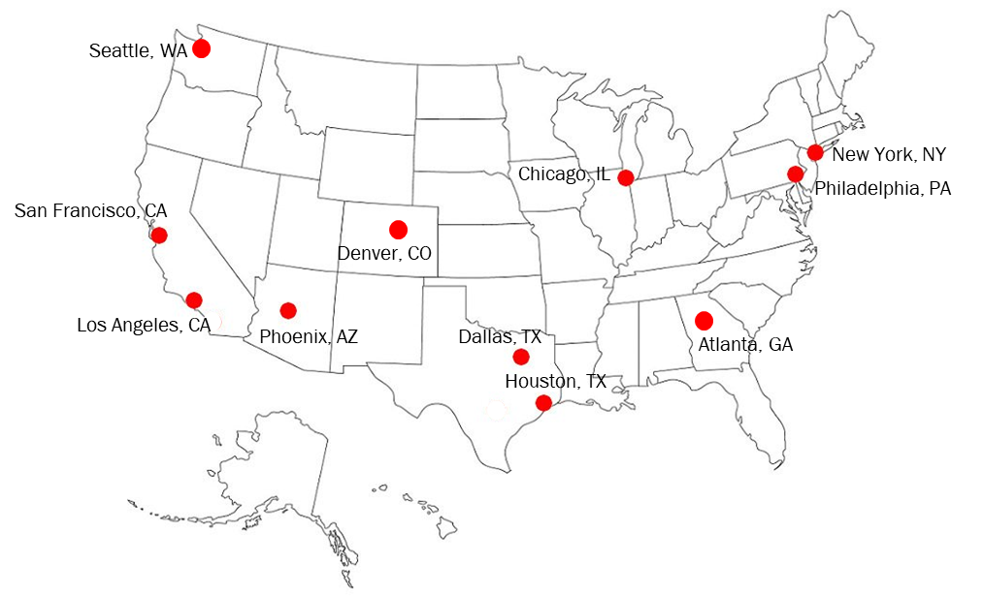
U.S. City Map of Locations

Slide 7
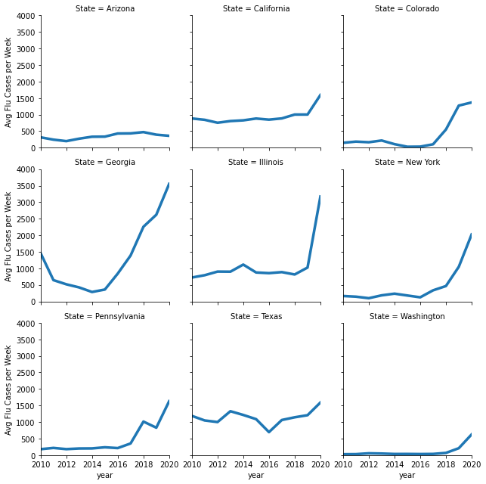
CDC Flu Weekly Data
Flu reporting is voluntary and varies widely state to state
CDC publishes weekly Total ILI (Influenza like Illness) and positive cases at FluView
Enrollment in reporting has increased over time and there were >3000 providers enrolled during the 2010-11 season
ILI Flu Cases are not population weighted and some areas are over reported (CDC is headquartered in Atlanta)
Notes:
-Areas where children are more likely will have higher numbers of cases

Slide 8
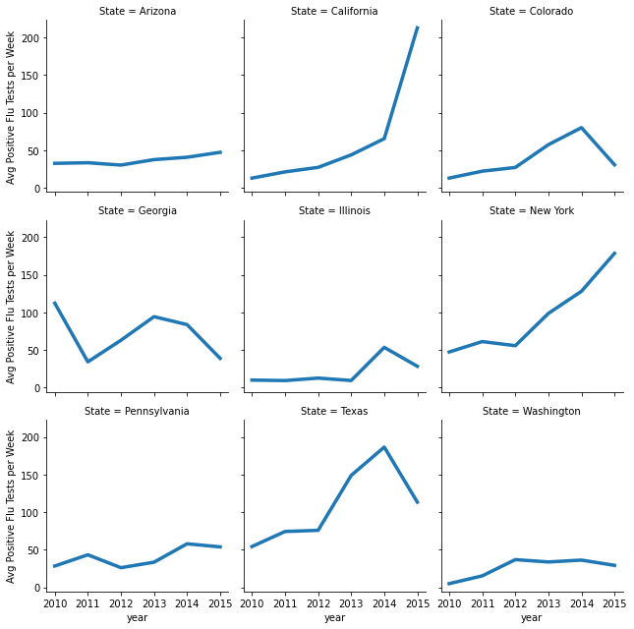
CDC Flu Weekly Data (cont.)
100 public health and 300 clinical Laboratories report to the CDC
Beginning in 2015-2016 flu season, CDC started reporting clinical and public health laboratory results separately
Clinical data still by week and year as prior
Public health now by season

Slide 9
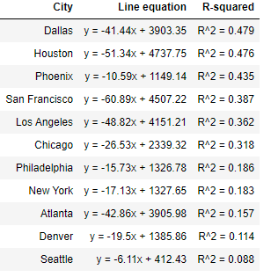
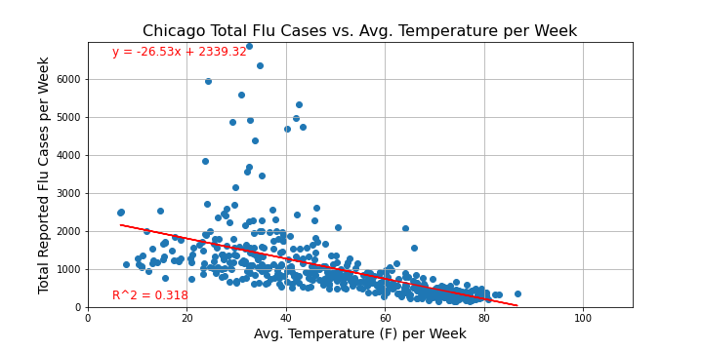
Analysis
Scatter Plots show clear relationship between Temperature and Flu cases
Reporting has increased overtime(see previous slide)
Individual R^2 would be higher in certain year but we looked at overall relationship
Certain Cities had a much higher R^2

Slide 10
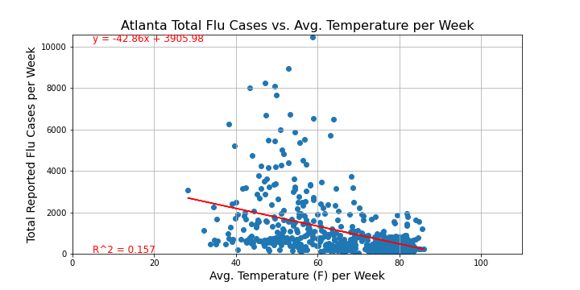
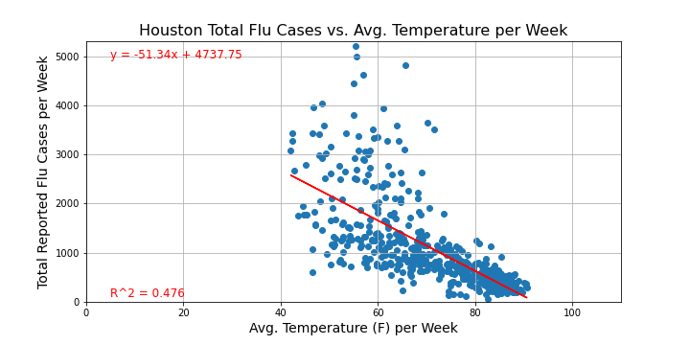
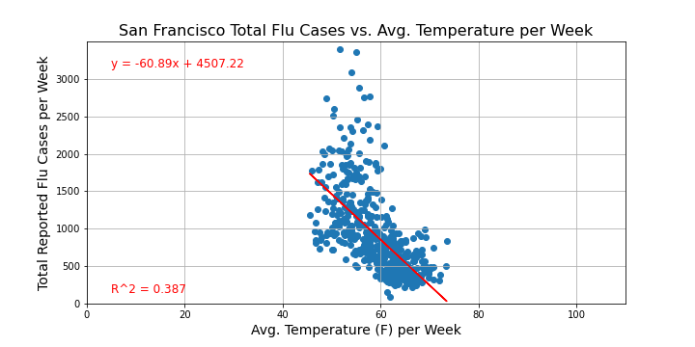
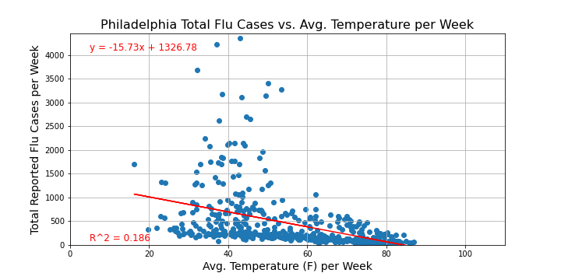

Slide 11
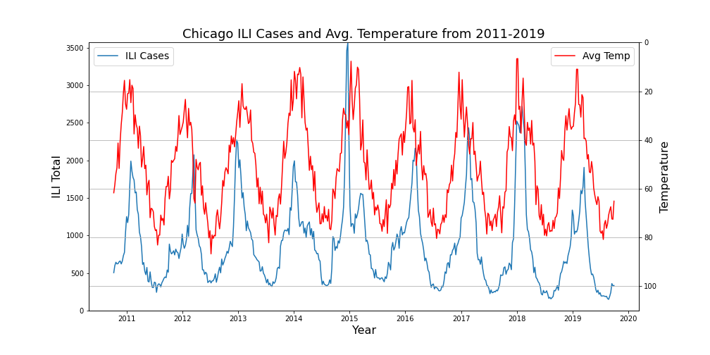
Time Series
Time Series Visually helps to show Seasonal peaks relationship
Flu Season tends to peak a couple weeks after winter
An auto-correlation study would help confirm this

Slide 12
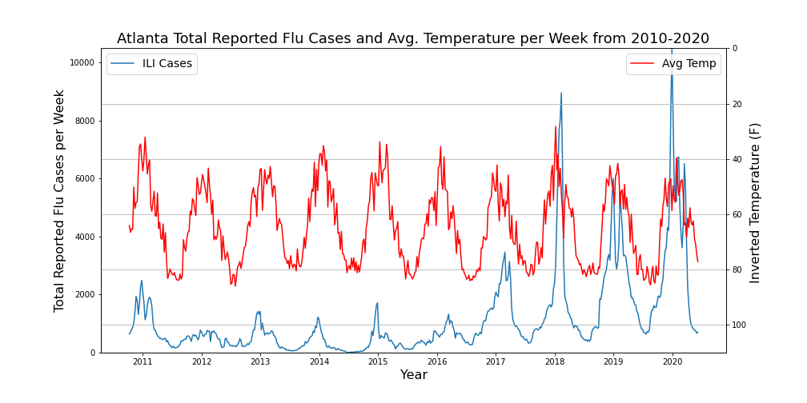
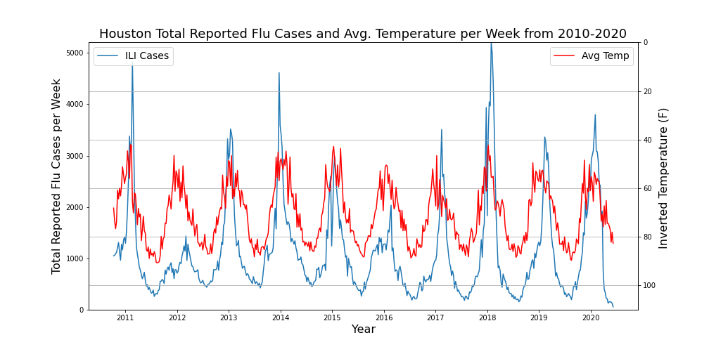
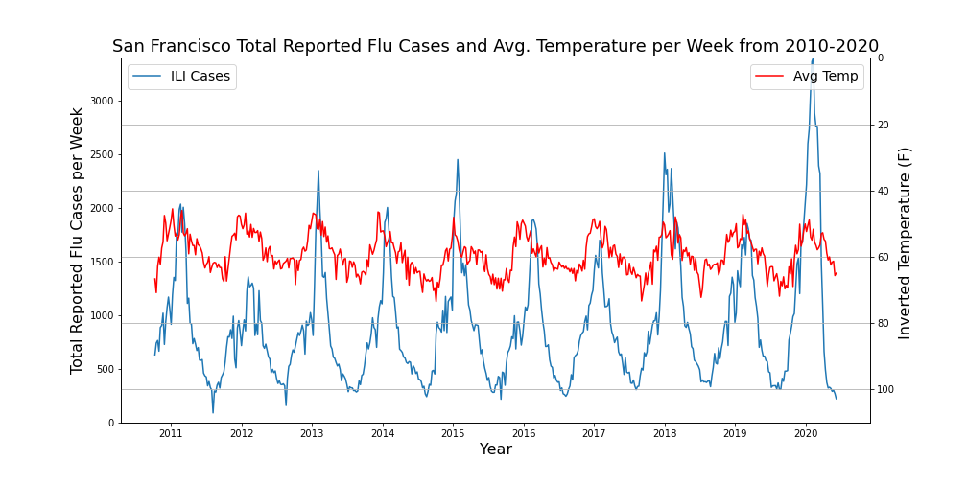
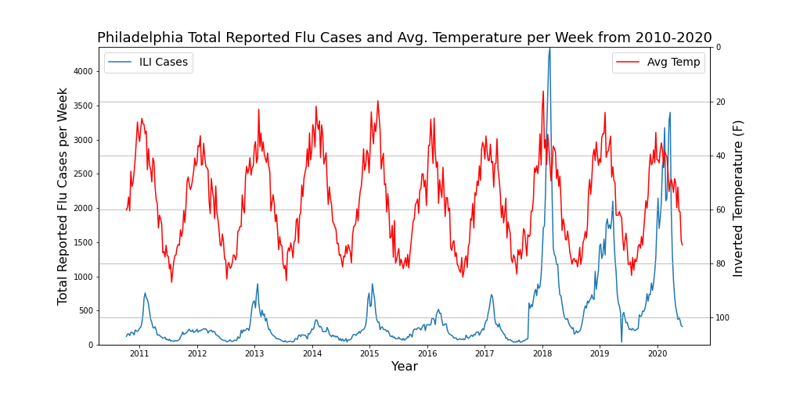

Slide 13
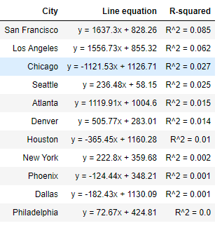
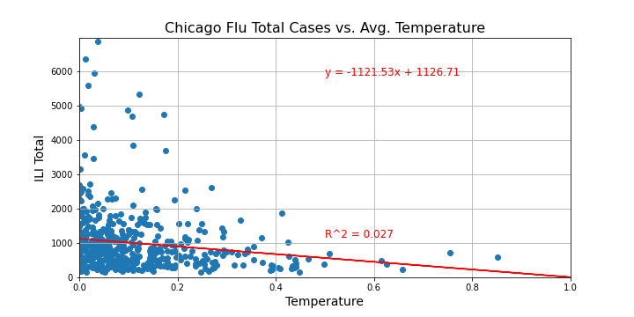
Comparing Other Weather Data
We ran the same comparison with the Flu ILI data and Precipitation
No/very little relationship between precipitation and Flu cases

Slide 14
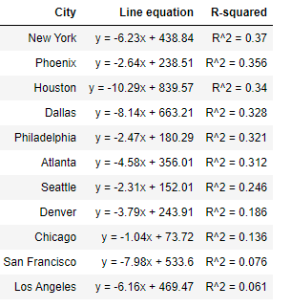
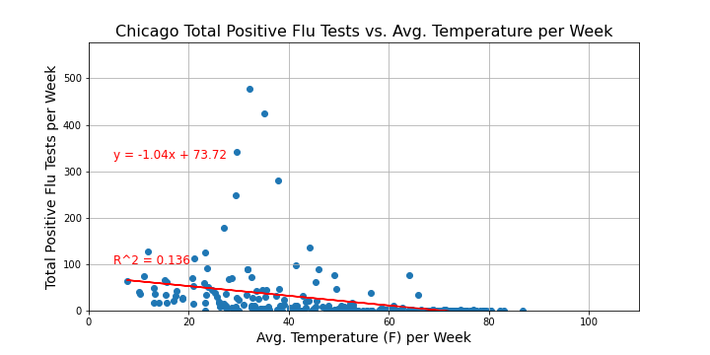
Flu Positive Test Cases
CDC/WHO published positive cases. We compared total positive cases to temperature data
Positive cases confirmed the relationship we saw in total cases

Slide 15
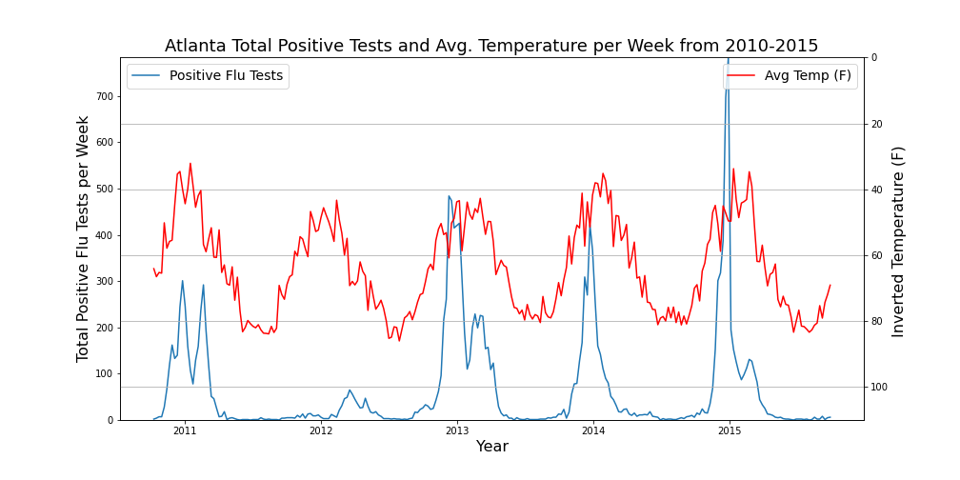
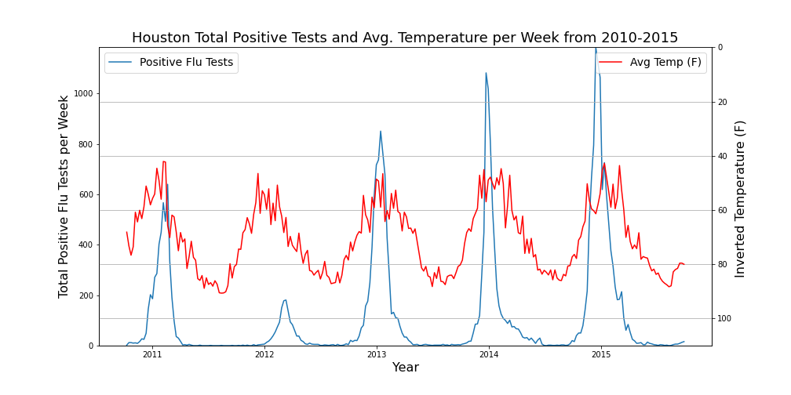
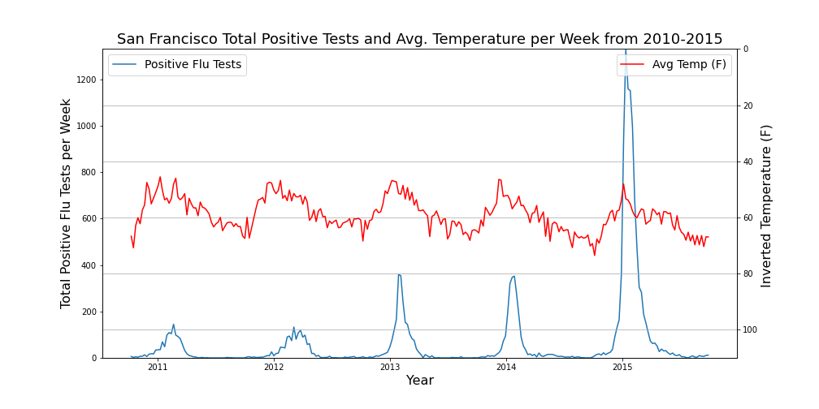
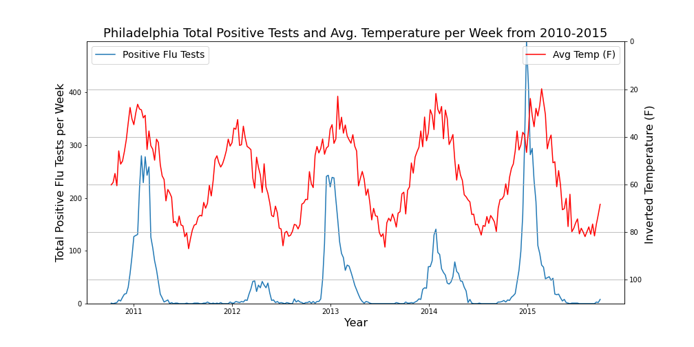

Slide 16
Conclusions
A clear relationship exists between colder temperatures and Flu season
Influenza-like illnesses reported by every city we looked at in the U.S., from 2010-2020, showed a negative correlation with increasing temperatures
The same was true with positive flu tests in every city
This relationship was even clearer when looking at the reported cases of both over time
There was no defined relationship between precipitation and Flu season
Each city showed very little correlation between increased flu cases and the amount of precipitation throughout the year

Slide 17
Post Mortem
Difficulties that arose
CDC data was by weeks, weather data was by days
Used function DateTimeFrame to group weather data by weeks and took average
Clinical labs and public health labs started reporting data separately in 2015-16 flu season
The positive test data past that season was not included for analysis as the reporting measures didn’t match up
Additional things to investigate:
Possible time correlation between peak amount of cases reported and lowest temperature
Is there a difference in peaks for types of flu (A vs. B)?
Other weather variables that may have influence
E.g. Does humidity play a factor in case totals?
May be able to normalize data based on number of reporting facilities (if that data can be found)

Slide 18

Questions?

